Slide 1

CAPSTONE
PROJECT
CAPSTONE
PROJECT
MACHINE LEARNING
Khushi M. Ojha
S9730

Slide 2

"THE CHALLENGE OF LAPTOP PRICING"
A SmartTech Co. Story

Slide 3
Content
02
Title of the Project
10
Exploratory Data Analysis
04
The Problem
12
Model Development
05
Objective
14
Evaluation of Performances
06
Approach
16
Comparison of Model
07
Data Pre-Processing
17
Key Insights & Conclusion

Slide 4



"The Need for Accurate Laptop Price Prediction"
Port Availability
Screen Size
B
R
M
A
W
E
I
G
H
T
Screen Resolution
M
N
D
P
R
O
C
E
S
S
O
R
R
Build Quality
A
O
P
S
Y
S
M
Battery Warranty Period
Battery Life

Slide 5



Objective
01
Accurate price prediction based on various laptop features.
Understanding the impact of brand reputation on pricing.
02
03
Helping SmartTech Co. to position their laptops strategically in the market.

Slide 6



Approach
Data Collection
Model Evaluation
Data Cleaning
Model Development
Data Pre-Processing
Exploratory Data Analysis

Slide 7
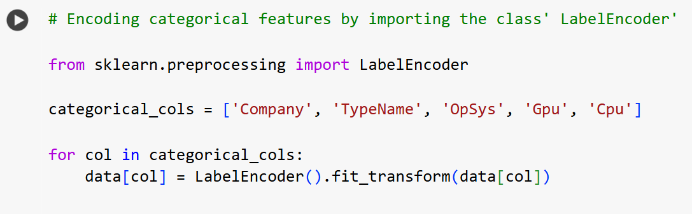
Data Pre-Processing
Step 01

Slide 8
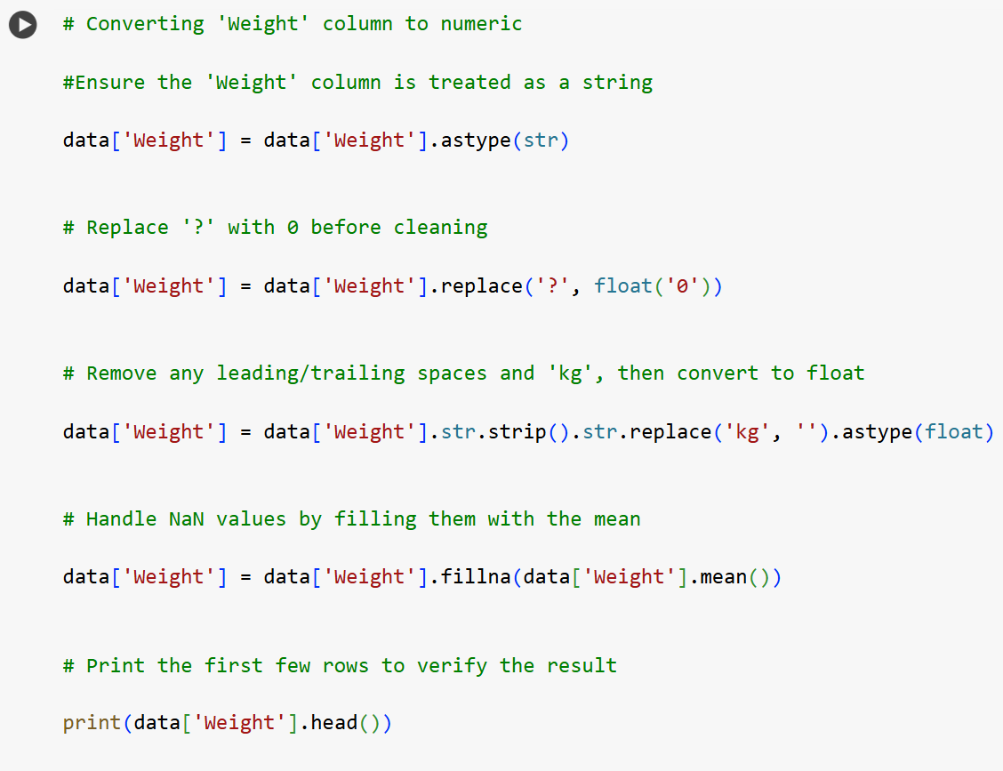
Data Pre-Processing
Step 02

Slide 9
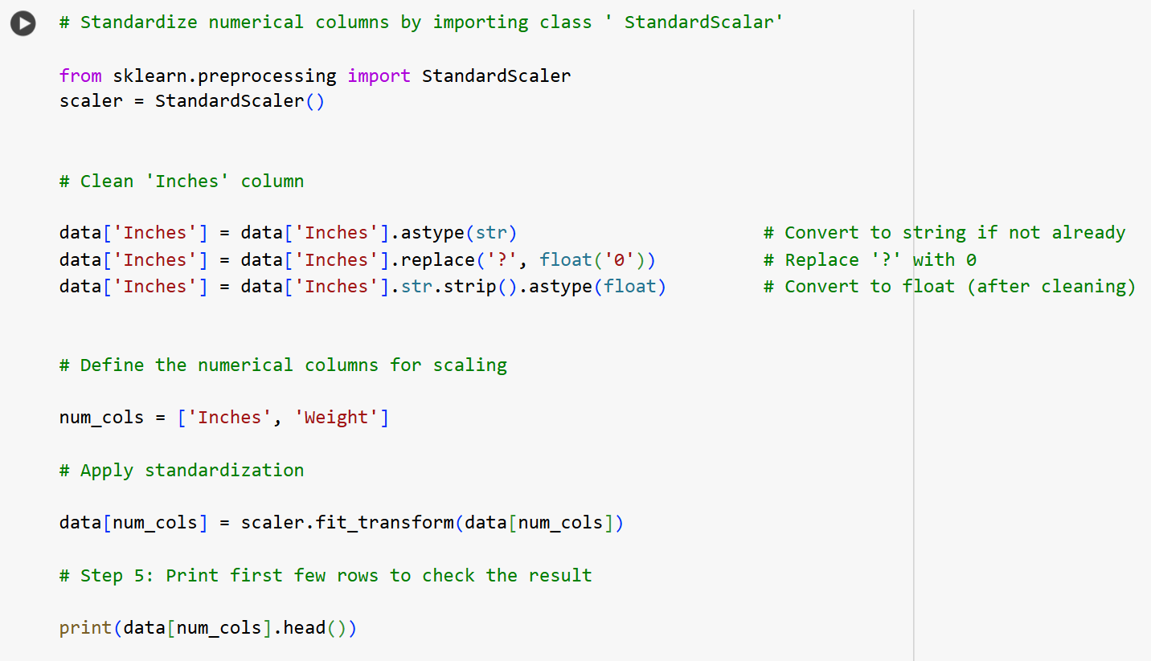
Data Pre-Processing
Step 03

Slide 10

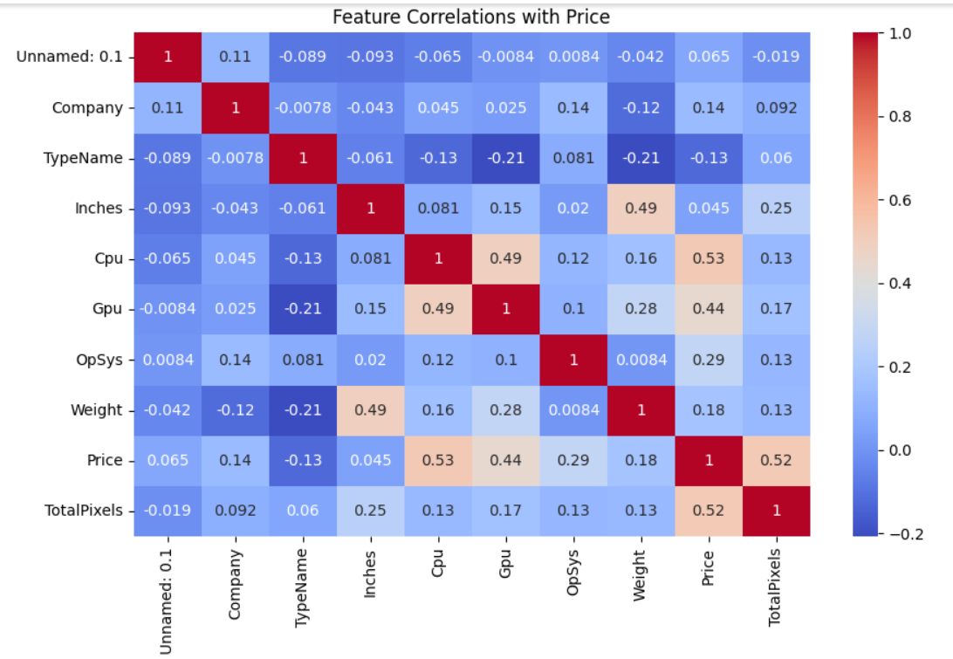
Exploratory Data
Analysis
Correlation
HeatMap

Slide 11
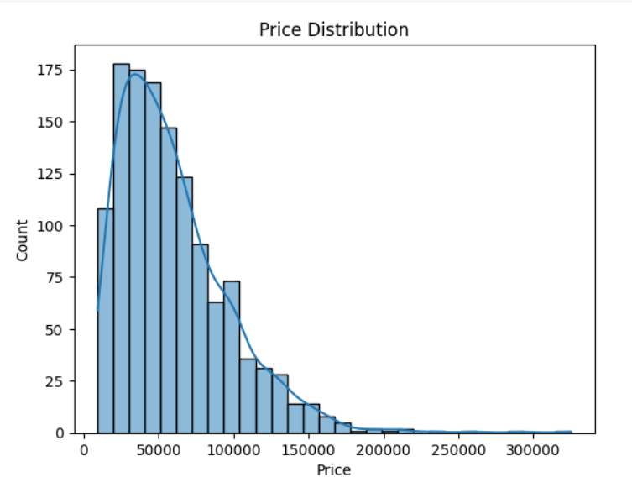
Exploratory Data
Analysis
Histogram

Slide 12
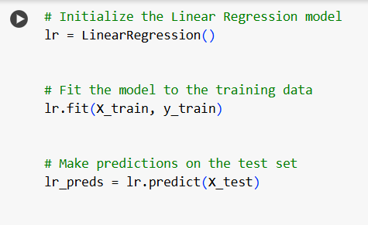
Model Development
Linear Regression Model

Slide 13
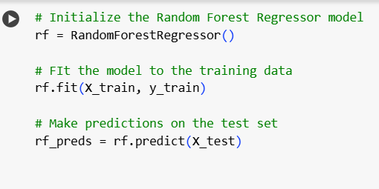
Model Development
Random Forest Regression Model

Slide 14
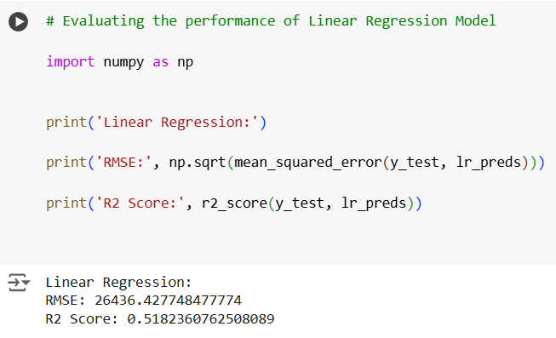
Evaluation of Performances

Slide 15
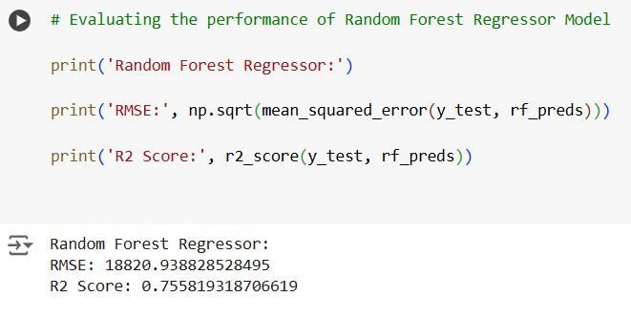
Evaluation of Performances

Slide 16
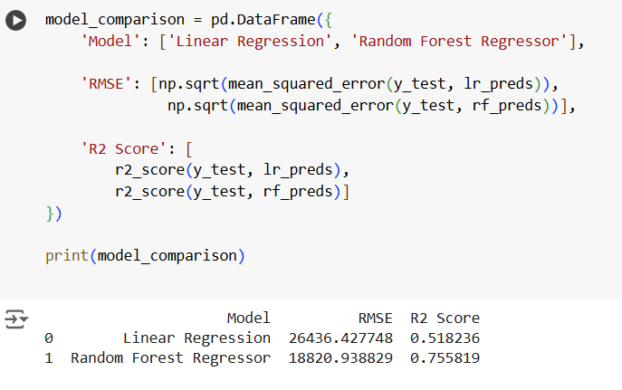
Comparison of Models

Slide 17


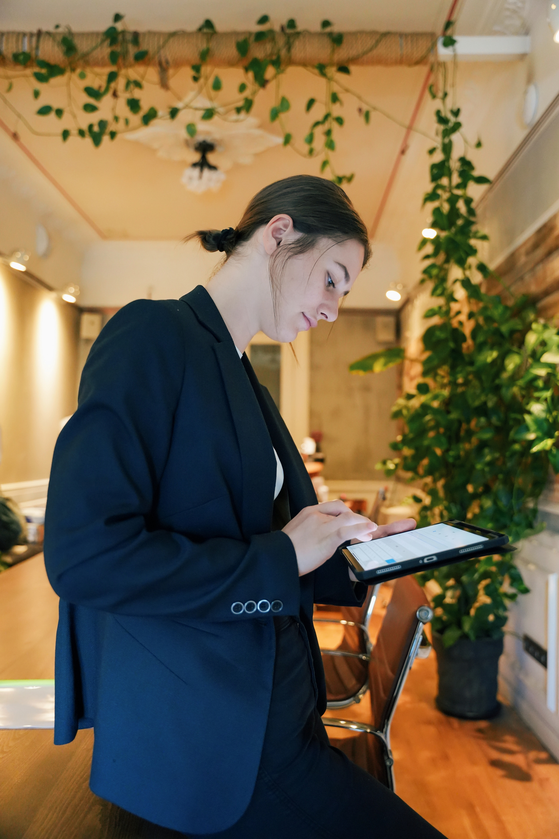
Key Insights
Feature Importance
Categorical Factor
Higher-end specifications correlate with higher prices
Lesser-known brands exhibit competitive pricing
Brand
Processor & RAM
Screen Size
Operating systems (e.g., MacOS, Windows) contribute to price variation
Pricing Variability

Slide 18
CONCLUSION
Empowering SmartTech Co. with Insights
Developed a machine learning pipeline for accurate laptop price prediction.
Gained insights into key factors influencing laptop pricing.
Provided SmartTech Co. with a tool to predict prices and understand market trends.

Slide 19
"Thank you for exploring
the world of laptop pricing.
Looking forward to smarter decisions for SmartTech Co.!"

